Slide 1
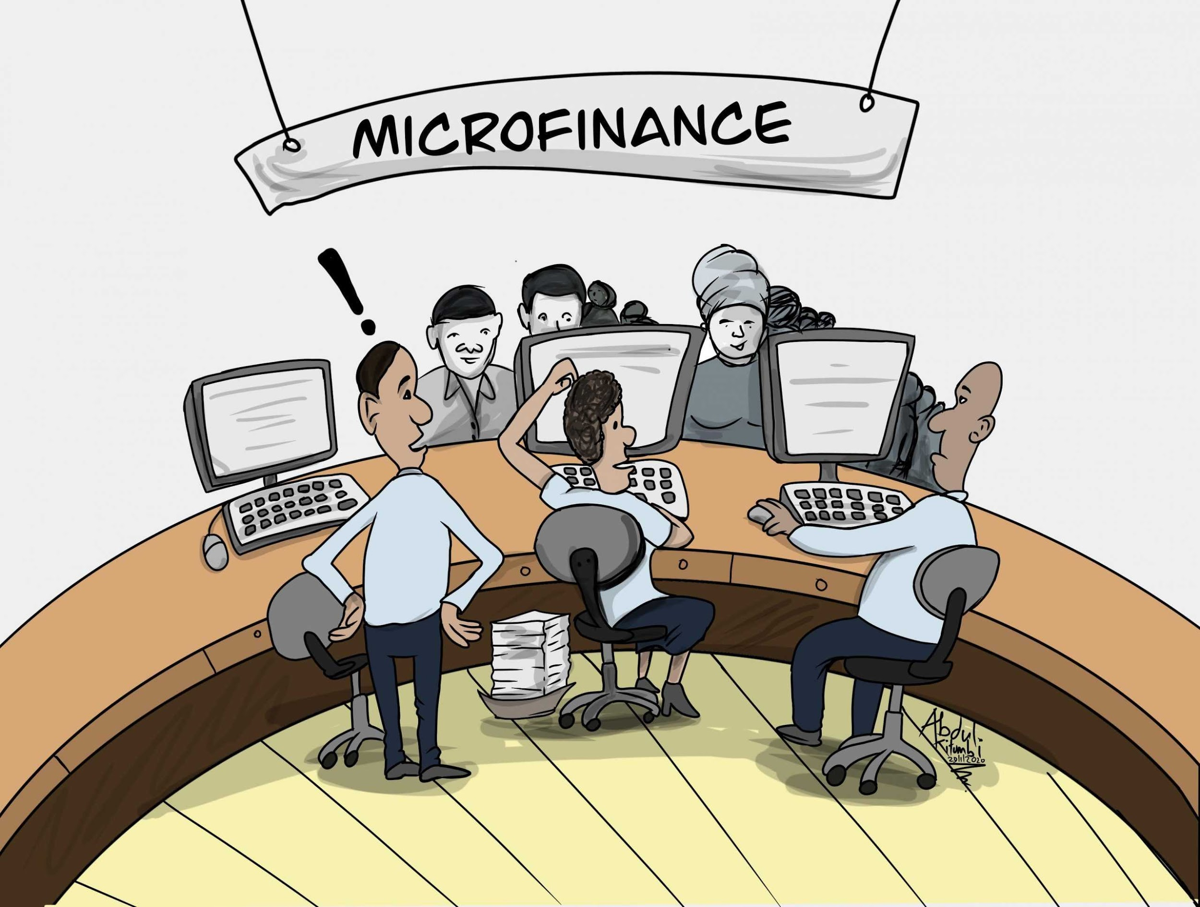
Micro-Credit Defaulter Project
Machine Learning
By, Utkarsh Vardhan

Slide 2

BackGround & Problem Statement:
Client - Telecom Industry from Indonesia.
MFI is an organization which provides financial services to low income groups.
They are collaborating with MFI to provide the micro credit on mobile balances
These credits to be paid back in 5 days otherwise he or she is a defaulters.
There are two loan amount : 5 and 10 Indonesian Rupiah which is having a pay back amount of 6 and 12 Rupiah.
Companies having problems in selecting their customers as if they can pay back the loan amount in 5 days of issuance of loan.
Loan amount = 5 and 10 Indonesian Rupiah on mobile balance, payback amount 6 & 12 respectively , Projects is based on the reality basis.

Slide 3
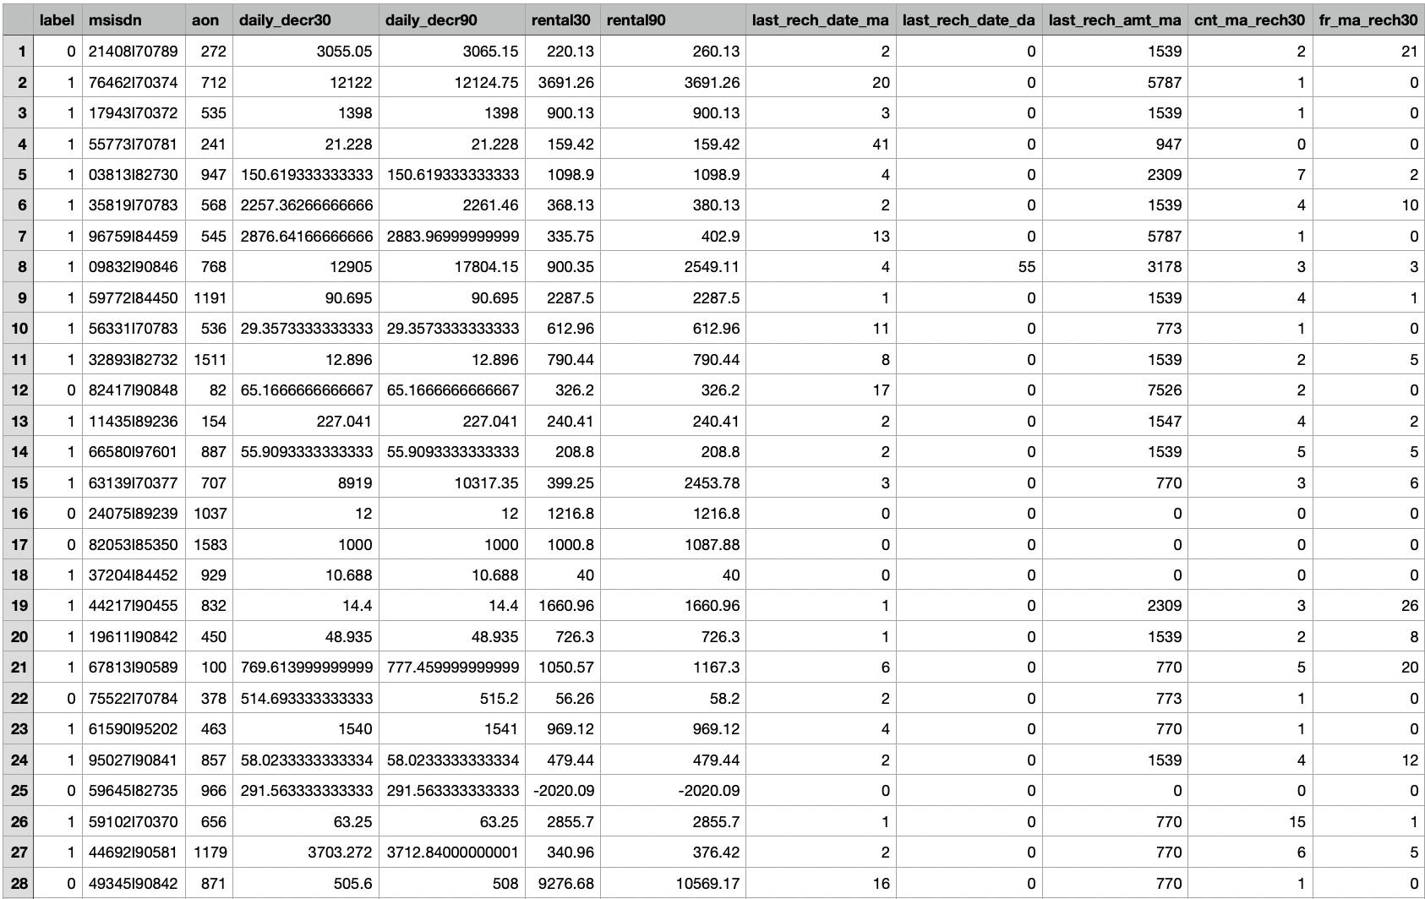
Data Shared
There are no null values present.
Target variable is “Label” 1 = Non Defaulters with 87.98% records , 0= Defaulters with 12.01% records.
As the data is expensive , so we are not allowed to lose more than 8 to 10 percentage of the data.
Shape of the data is : 209593 rows * 36 columns.
Data types are int64(12), object(1), float(21), datetime64(1).

Slide 4


Data Cleaning Steps:
Removing erroneous values
Separate columns of year, day , month.
Checking Missing Values
Dropping Columns
Checking Uniqueness
Synthesizing Date Column

Slide 5
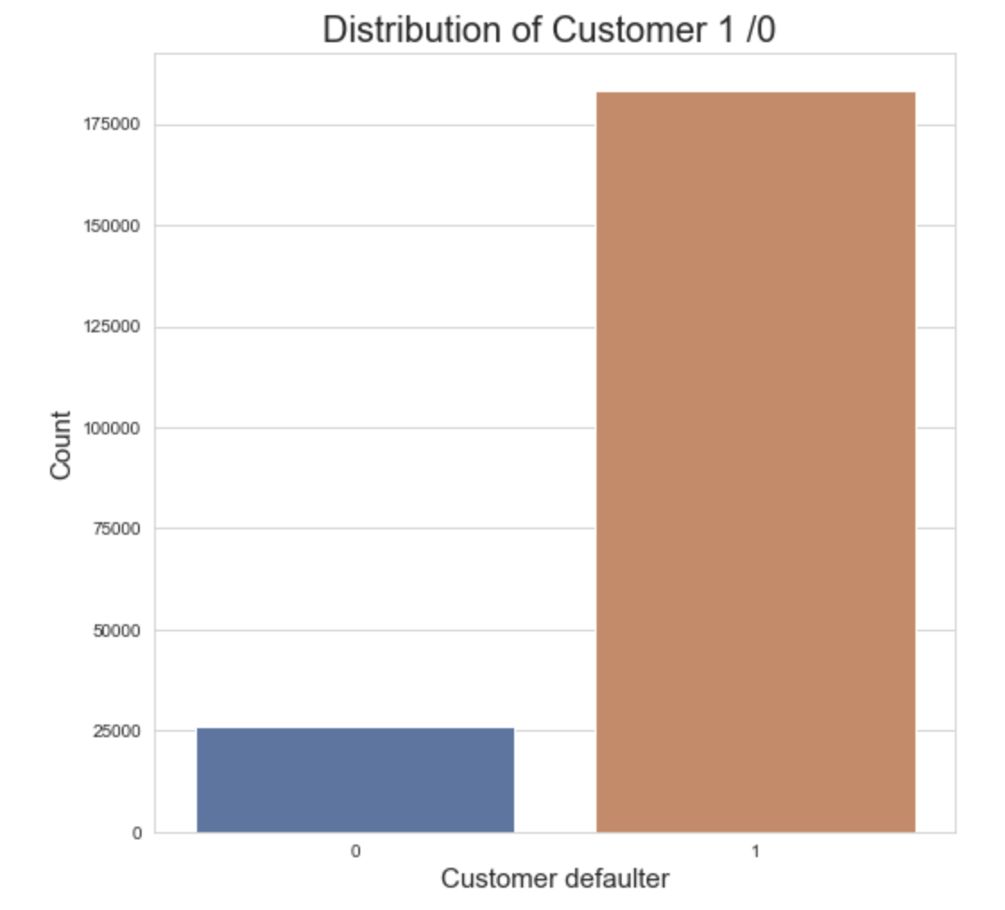
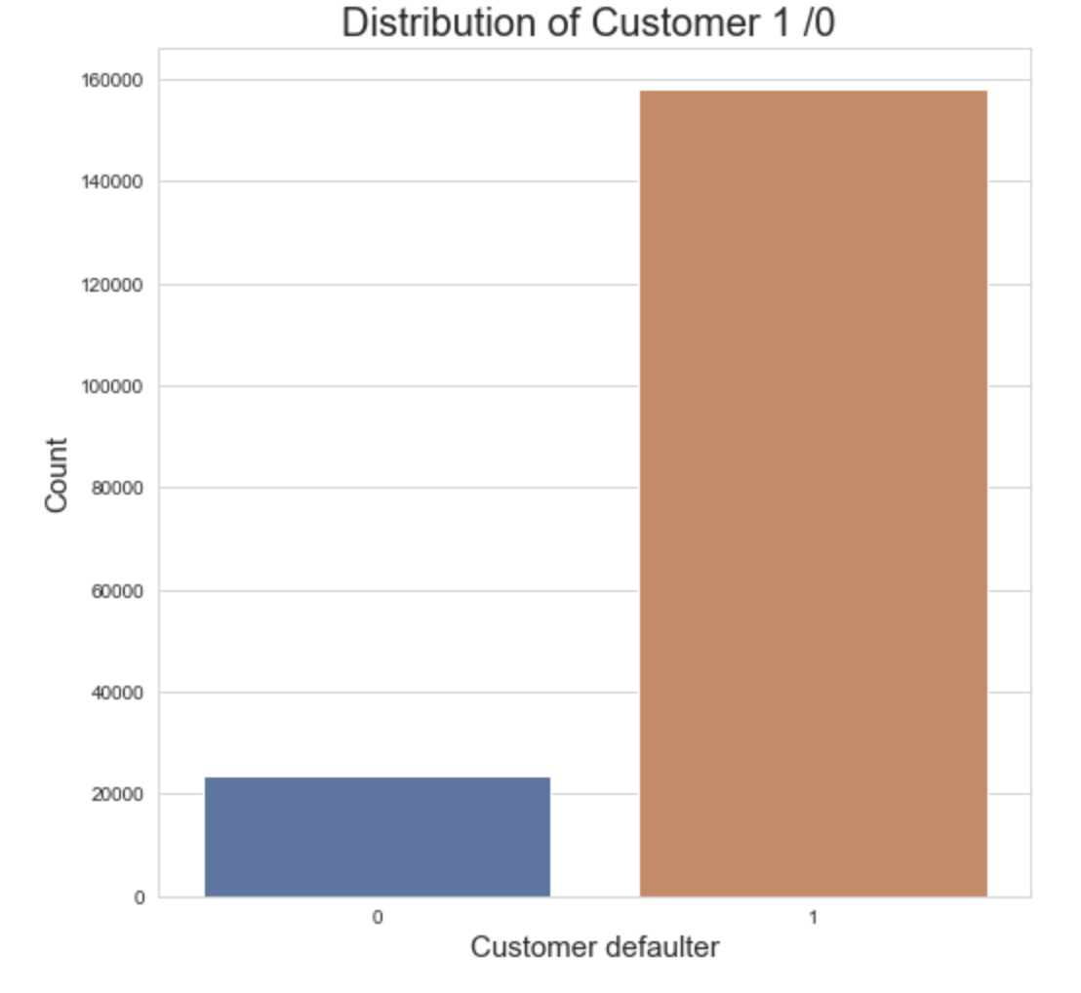
Distribution of the Target Variable Before and After removing Outliers
Before
After

Slide 6
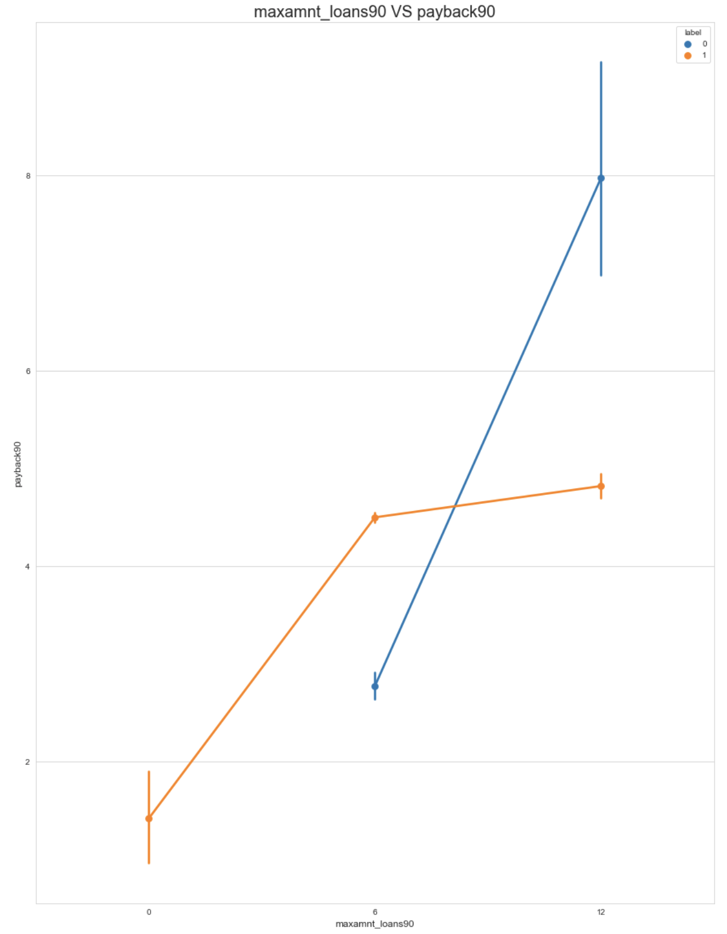
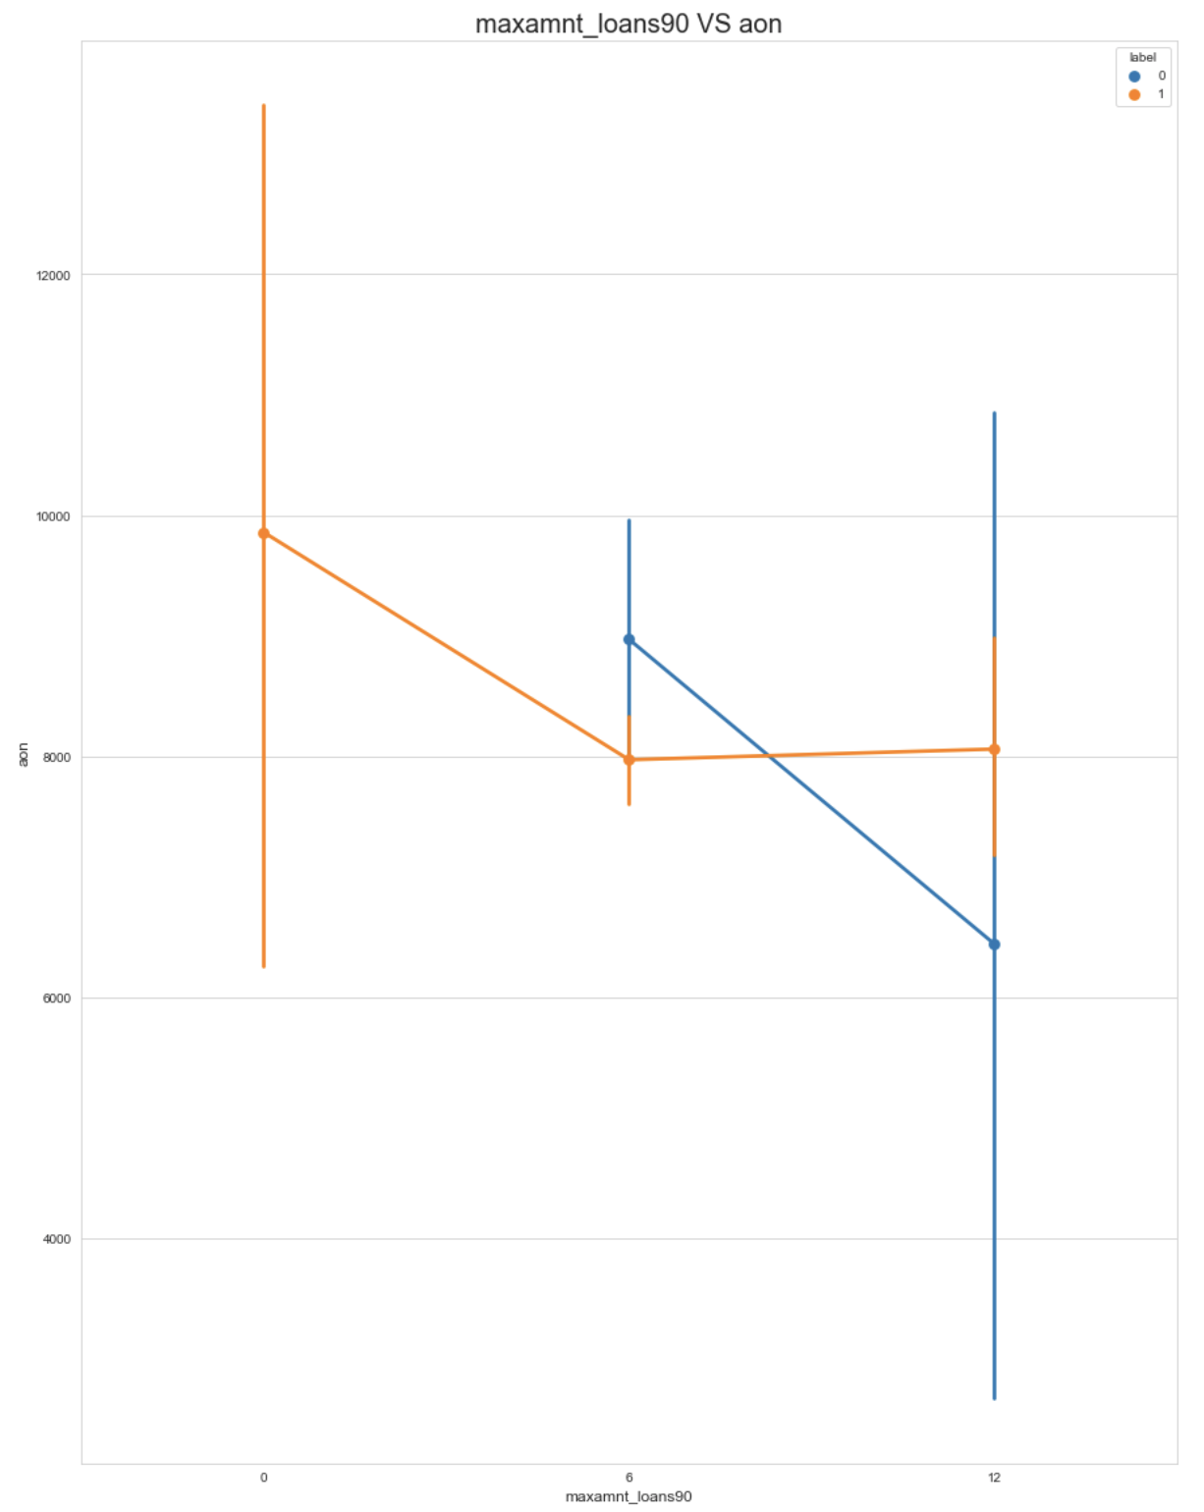
Maxmnt_loan90 VS payback90 with Label Data
Maxmnt_loan90 VS aon with Label Data

Slide 7
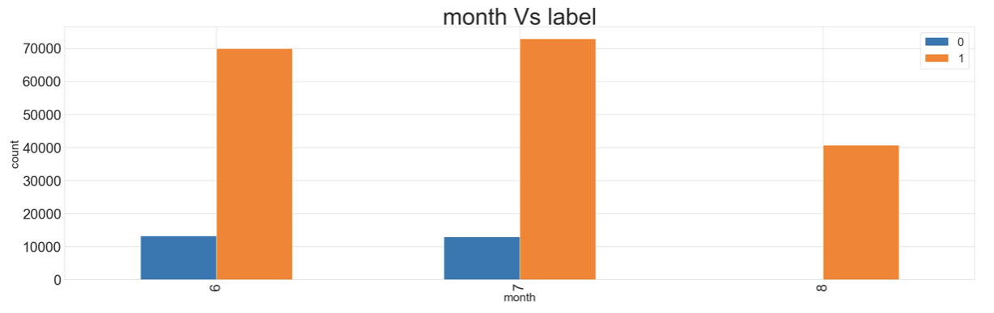
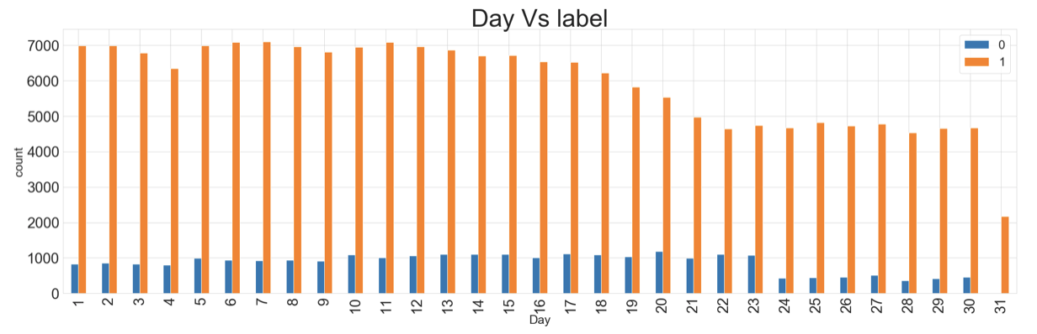
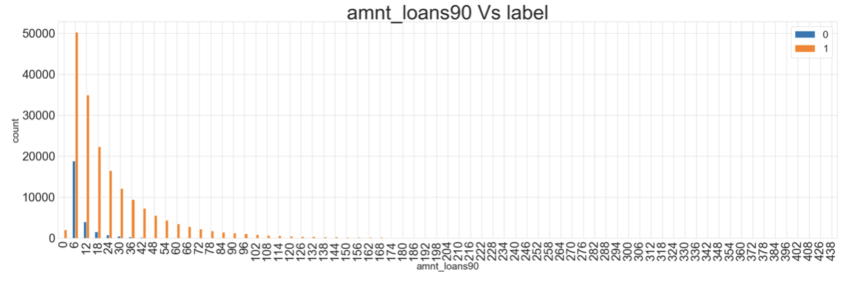
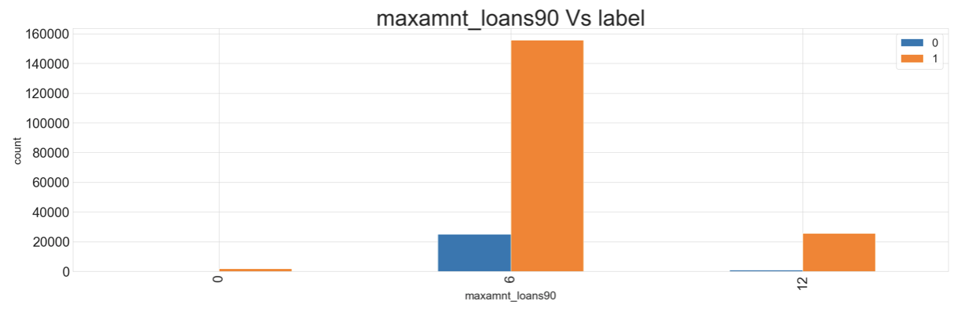
Distribution of Label Data
month
Day
amnt_loans90
maxamnt_loans90

Slide 8

Key Metrics Used:
Accuracy score
Cross_val_score
Roc_AUC_score
Classification report
Confusion Matrix
True positive rate and False positive rate Statistical graph.
Heat map Axes Subplot plot([0,1],[0,1
F1 - Score

Slide 9
Model Testing
Model | Accuracy Score | Recall score “0” | Roc Auc Score | Cross Val Score
LogisticRegression | 71.87% | 84% | 77.13% | 71.63%
GaussianNB | 65.67% | 79% | 71.45% | 65.11%
DecisionTreeClassifier | 84.77% | 40% | 65.45% | 84.82%
RandomForestRegressor | 89.84% | -- | -- | 26.35%
SVC | 76.39% | 84% | 79.86% | 75%
KNeighborsClassifier | 89% | 30% | 63.66% | 96.96%
AdaBoostClassifier | 89.26% | 28% | 62.62% | 97.66%
RandomForestClassifier | 77.49% | 82% | 79.44% | 76.98%

Slide 10

After removing the outliers the distribution of Target Variable was maintained almost same as before.
Removal of the data ‘pcircle’ as it has only one unique array, ‘pdate’ & ‘year’ as month and day has been separated.
If Age on the cellular network is more than 6000 days or 8000 days then the customers are predicted not to be the defaulters and the customer who have joined recently or below 6000 days may be there is a chance of predicting them as a defaulters.
Maximum loan amount of 6 Rupiah in last 90 days defaulters ranging from 22000 to 24000 when compared to 12 Rupiah.
Amount loan of 6 Rupiah in the last 90 days has been taken by a maximum number of customers.
Maximum defaulters which have not paid the loan or the total amount of loans taken by the users in last 90 days is maximum for 6 Rupiah i.e. The amount of 6 Rupiah is the amount where the maximum number of users have paid and not paid the loan.
It has also come to our notice that the maximum amount of loan in the last 90 days is maximum for 6 Rupiah with respect to the 12 Rupiah.
I am choosing SVC to be my best model in order to predict the target variable.

Slide 11
THANK YOU

